Slide 1
Bob Briody
Network Analysis Adventure

Slide 2
Who is this guy?

Slide 3
Who are these people?
Notes:
First question: how many of you would primarily identify as some form of developer, software engineer, hacker, programmer, whatever?

Slide 4
What is your role?

Slide 5
TinkerPop / Gremlin

Slide 6
Network Analysis

Slide 7
Property Graph
Set of Vertices
Set of outgoing edges
Set of incoming edges
Set of Edges
Single outgoing tail vertex
Single incoming head vertex
Vertices & Edges
Unique ID
Collection of properties
Label denoting type

Slide 8
What is Network Analysis?

Slide 9
Why should you care?

Slide 10
Some Product Questions…
I want to understand our user/customer base in the aggregate.
What are the underlying communities among our users/customers?
I need to mediate a conflict between some groups of employees. Who should I talk to?

Slide 11
The Graph Analysis Spectrum
Product Domain
Academic Domain
Graph
Analysis
Computing
Methods
Solutions
Domain Specific
General

Slide 12
The Product Domain
Product Domain
Academic Domain
Graph
Analysis
Computing
Methods
Solutions
Master Data Management
Recommendation and Personalization
IoT, Asset Management, and Networking
Security Management and Fraud Detection
Criminal Network Analysis

Slide 13
The Academic Domain
Product Domain
Academic Domain
Graph
Analysis
Computing
Methods
Solutions
Types of Network Analysis:
Social
Network (IT)
Economical
Supply Chain
Literary
Web
Biological

Slide 14
Terminology
Product Domain
Academic Domain
Graph
Analysis
Computing
Methods
Solutions
Graph = Network
Vertex = Node
Edge = Link or Relationship

Slide 15

A quick note on Edge Labels.

Slide 16
Social Network Analysis
Product Domain
Social Network Analysis
Graph
Analysis
Computing
Methods
Solutions
Domain Specific
General
It’s all about the
people.

Slide 17
Some Social Network Analysis Questions…
I want to understand our user/customer base in the aggregate.
Counts, Degree Distribution, Density
What are the underlying communities among our users/customers?
Community Detection, Modularity
I need to mediate a conflict between some groups of employees. Who should I talk to?
Bridges & Brokers -> Centrality, PageRank

Slide 18
Centrality
Identify the most “important” vertices in the graph.
Degree
Betweenness
Eigenvector, PageRank
etc…

Slide 19
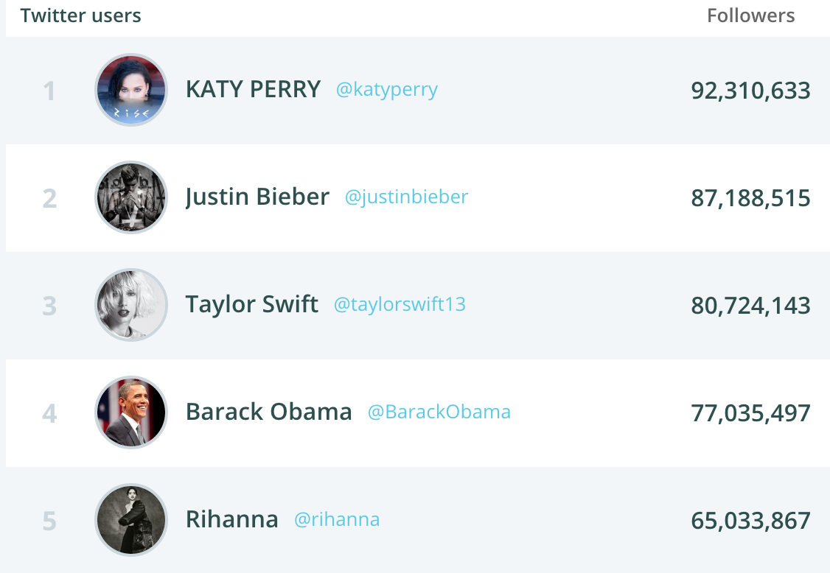
Degree Centrality
Number of edges incident upon a
vertex.

Slide 20
Betweenness Centrality
Number of times a vertex appears along the shortest path between two other vertices.

Slide 21
Bridges & Brokers
Bridge: An individual whose weak ties fill a structural hole, providing the only link between two individuals or clusters.
Brokerage: Vertex lies between others.

Slide 22
PageRank
Based on the concept that connections to high-scoring vertices contribute more to the score of the vertex in question than connections to low-scoring vertices.

Slide 23
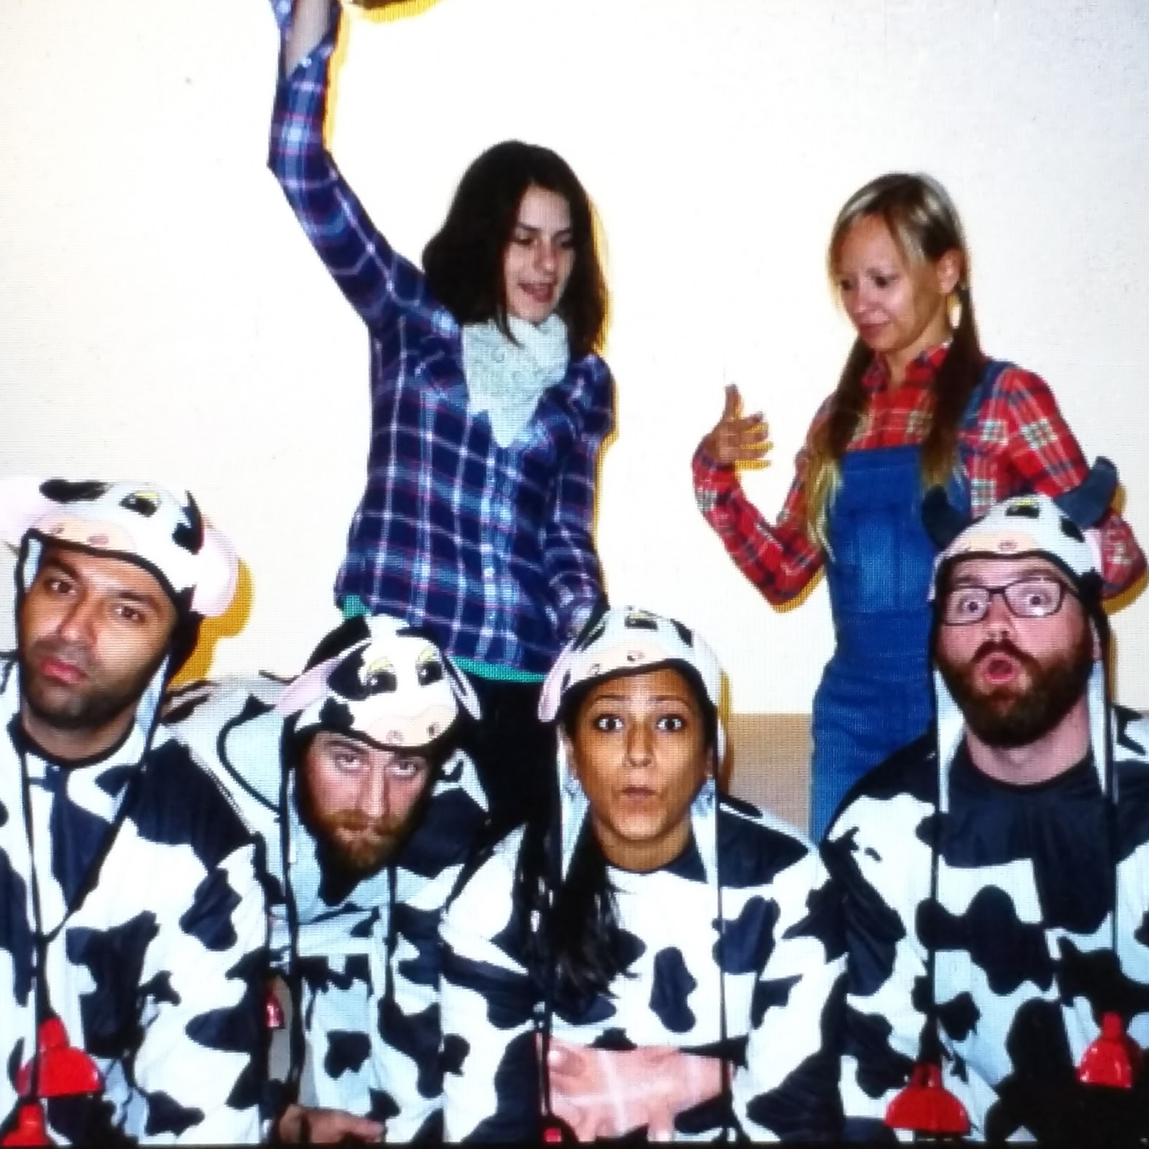
Homophily
”Birds of a feather flock together.”

Slide 24
Graph Analysis
Product Domain
Social Network Analysis
Graph
Analysis
Computing
Methods
Solutions
Graph
Vertex & Edge Counts
Degree Distribution
Avg Degree
Degree Density
Domain Specific
General
Vertex
Clustering, Community Detection, Modularity
Centrality, PageRank
Path
Traversals, Pattern Matching

Slide 25
Graph Analysis
Product Domain
Social Network Analysis
Graph
Analysis
Computing
Methods
Solutions
Graph
Vertex & Edge Counts
Degree Distribution
Avg Degree
Degree Density
Oh and btw…
ALL STANDARD
DATA ANALYSIS
TECHNIQUES!!!
Domain Specific
General
Vertex
Clustering, Community Detection, Modularity
Centrality, PageRank
Path
Traversals, Pattern Matching

Slide 26
Solutions
Product Domain
Academic Domain
Graph
Analysis
Computing
Methods
Solutions
Gremlin is a functional, data-flow language that enables users to succinctly express complex traversals on (or queries of) their application's property graph.
Apache TinkerPop™ is a graph computing framework for both graph databases (OLTP) and graph analytic systems (OLAP).
A scale-out property graph database built on DataStax Enterprise, Apache Cassandra, and…
Apache Spark™ is a fast and general engine for large-scale data
processing.

Slide 27
Some Social Network Analysis Questions…
I want to understand our user/customer base in the aggregate.
Counts, Degree Distribution, Density
What are the underlying communities among our users/customers?
Community Detection, Modularity
I need to mediate a conflict between some groups of employees. Who should I talk to?
Bridges & Brokers -> Centrality, PageRank

Slide 28
Further Learning
Gremlin Recipes
http://tinkerpop.apache.org/docs/current/recipes/
Lada Adamic
Computational Social Scientist @ Facebook
http://www.ladamic.com/
Stanford University - Social and Economic Networks: Models and Analysis
https://www.coursera.org/course/networksonline

Slide 29
Try it yourself!!!
Twitter Exporter
https://github.com/rjbriody/twitter-exporter
Studio Notebook Gist
https://gist.github.com/rjbriody/1aa82bd8952dc4a46a6fa597716c1987
DSE Graph
https://docs.datastax.com/en/latest-dse/datastax_enterprise/graph/graphTOC.html
Studio
http://docs.datastax.com/en/latest-studio/

Slide 30
Find Me
www.bobbriody.com
Twitter
@bobbriody
https://twitter.com/bobbriody
Github
rjbriody
https://github.com/rjbriody

